Slide 1
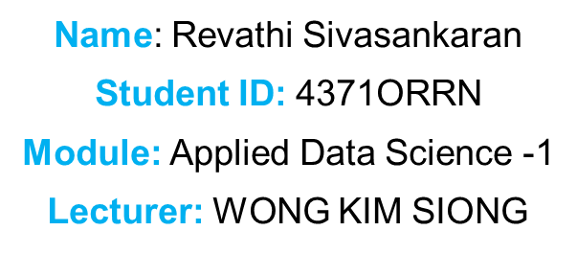
Fitting And Clustering- Car Price Prediction
Github:

Slide 2
Introduction
This dataset includes a wide range of cars from brands like Honda, Ford, BMW, Audi, and Toyota.
Each record has details like the make, model, year, engine size, mileage, fuel type, transmission, and price.
The data lets us explore how things like the car’s age, mileage, and engine size affect what people pay for a car.
We’ve got examples of petrol, diesel, and electric vehicles, so it’s good for market segmentation.
I used this data for regression and clustering to spot price trends and group similar cars together.
Overall, it’s a great dataset for understanding real car market behavior and practicing machine learning techniques.
Dataset Link:
https://www.kaggle.com/datasets/amjadzhour/car-price-prediction

Slide 3
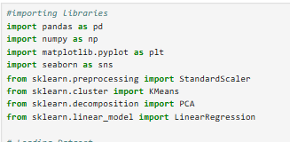
Importing Required Libraries
In the first step, I imported all the essential Python libraries needed for data analysis and machine learning in this project.
pandas and numpy help handle and process the data.
matplotlib and seaborn are used for making charts and visualizing patterns in the dataset.
Standard Scaler from sklearn is needed to standardize numeric values before modeling.
K Means (for clustering), PCA (for reducing data to 2D), and Linear Regression (for finding relationships) are all machine learning tools from sklearn.
Importing these libraries sets up my coding environment and allows me to perform all the steps in car price prediction analysis.

Slide 4
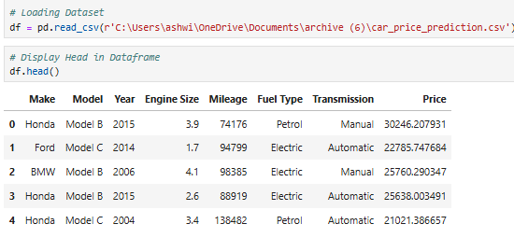
Dataset Overview
The dataset has several columns for each car, including Make, Model, Year, Engine Size, Mileage, Fuel Type, Transmission, and Price.
I loaded the dataset using pandas and displayed the first few rows to check the format and data types.
Brands included are Honda, Ford, BMW, Audi, and more, giving a nice variety of vehicles.
Car ages range from older models (like 2004) to newer ones (like 2015) in just the first few rows.
Prices in the dataset vary widely, which is good for analyzing what features influence car value.
Looking at the data head helped me understand how to proceed with further analysis like plotting, regression, and clustering.

Slide 5
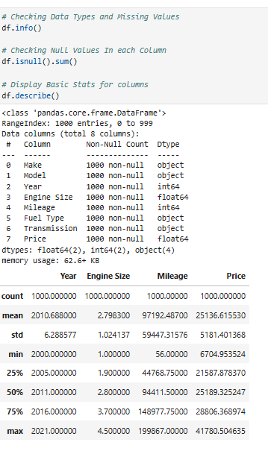
Data Types, Missing Values & Statistical Summary
I checked the data types and confirmed there are no missing values in any column—so the dataset is clean.
There are 1,000 car records, each with 8 columns including brand, year, engine size, mileage, fuel type, transmission, and price.
The average (mean) car in the dataset is from the year 2010, but models range from as old as 2004 to as new as 2021.
Mileage varies widely, with an average of about 97,000 km—showing both lower and higher use cars are included.
Engine sizes range from 1.0L to 5.0L, and prices go from around 6,700 up to over 41,700 (currency units).
This information confirms we have a lot of diversity across years, engine sizes, and prices, making the dataset suitable for both clustering and regression analysis.
The summary statistics help set expectations for what price bands, car ages, or engine sizes might represent in later plots.

Slide 6
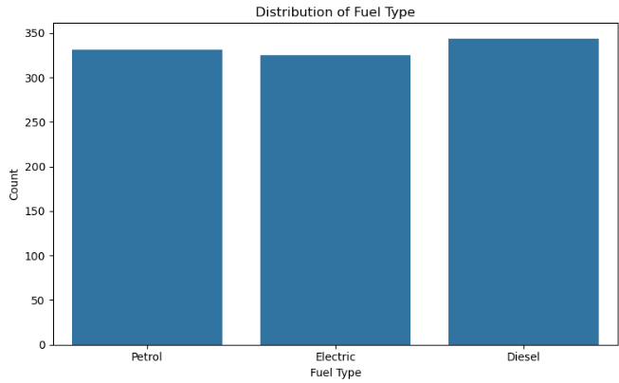
Bar Chart
The bar chart displays counts for petrol, diesel, and electric cars in the dataset.
Each fuel type is almost equally common, with about one-third of the cars in each group.
This balanced sample allows fair comparison between the price and popularity of petrol, diesel, and electric vehicles.
Including electric vehicles highlights how car technology is changing and makes the analysis realistic for today’s market.
By comparing features across fuel types, we can find out if running on electricity, petrol, or diesel affects a car’s resale value.
This information sets the foundation for clustering cars and predicting prices based on what powers them.

Slide 7
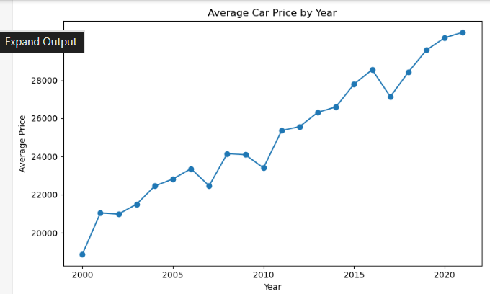
Line Chart
This line chart shows how the average used car price changes by model year in our dataset.
There’s a clear upward trend—newer cars tend to sell for much higher prices.
The average price moved from about 19,000 for cars from the early 2000s to over 31,000 for cars from around 2021.
Some small dips and jumps happen, likely due to changes in the number or types of cars for certain years.
This trend makes sense: people will pay more for cars that are newer or have updated features.
This shows that year is a very important factor when we predict price or look for car segments.

Slide 8
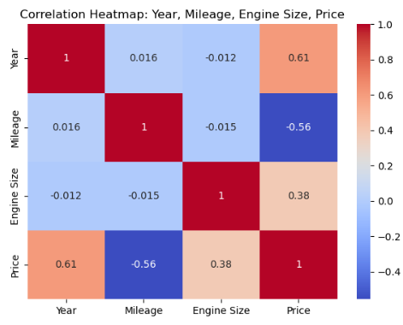
Correlation Heatmap
This heatmap shows how four main features relate to each other and to price: year, mileage, engine size, and price.
There’s a strong positive correlation (0.61) between year and price, meaning newer cars are more expensive.
Mileage has a strong negative correlation with price (-0.56), so higher mileage cars are usually cheaper.
Engine size is moderately positively correlated with price (0.38), which could mean bigger engines often cost more.
The other features like year and mileage don’t have much correlation—changes in one don’t really affect the other.
These results help confirm which features are most important for car value and for building prediction models.

Slide 9
Feature Selection & Scaling
I started by selecting only the most important numeric features for clustering: Year, Mileage, Engine Size, and Price.
I left out non-numeric columns like Brand or Fuel Type to keep the K Means input simple and reliable.
To make sure all features matter equally, I used StandardScaler to standardize their values.
This scaling step means features like Mileage (which has huge numbers) don’t overpower the others in the clustering.
Scaling is a key step before running K Means, as it prevents any one feature from dominating the results due to its scale.
By doing this, I made sure my clusters would be based on real differences in cars, not just on large numbers.

Slide 10
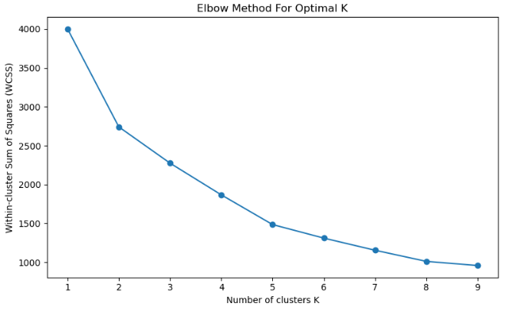
Elbow Method
The elbow chart helps me pick the best number of clusters (K) for grouping cars.
On the Y-axis, we have “Within-Cluster Sum of Squares” (WCSS), which measures how close cars are to their cluster center.
As I increase K, the WCSS gets smaller, but after a point, the improvement starts to slow down.
The “elbow” or bend in the curve is where we get the most value for adding clusters before returns start to drop.
In my chart, the elbow is around K=3 or K=4, which suggests that 3 or 4 groups make sense for segmenting these cars.
Picking the right K is important because it decides how well clusters show real differences in car features and prices.

Slide 11
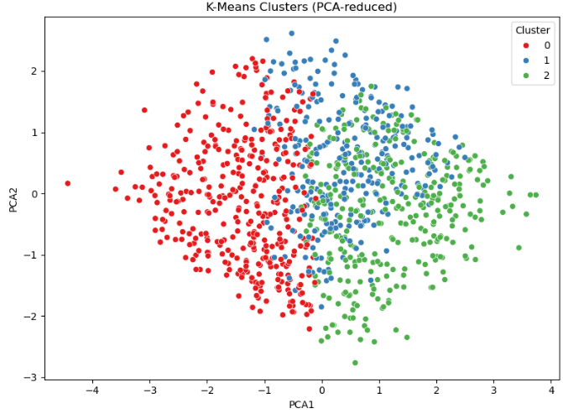
K-Means Clustering with PCA Visualization
I used K-Means to split the cars into 3 clusters based on year, mileage, engine size, and price.
The scatter plot shows how cars are grouped, using PCA to make it easier to see in just 2 dimensions.
Each color represents a different group of cars with similar features.
Clusters help us find patterns—for example, one group might have mostly older, high-mileage cars, while another has newer, expensive cars.
This can reveal market segments, like budget, mid-range, and premium used cars.
Understanding these clusters is important for car dealers and buyers, since it shows what types of cars are most similar in the market.

Slide 12
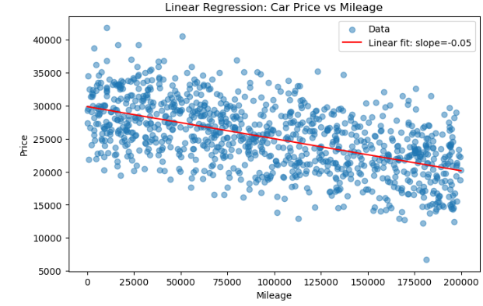
Linear Regression: Car Price vs. Mileage
The scatter plot shows the relationship between car price (y-axis) and mileage (x-axis) for all cars in the dataset.
There’s a clear downward trend: as mileage increases, car prices tend to decrease.
The red line is the linear regression fit, showing this negative correlation with a slope of about -0.05.
This means that, on average, for every extra kilometer on the car, the price drops by about 0.05 units (currency).
The fit line summarizes the general trend, but individual cars can still be above or below the line depending on other features.
This analysis confirms that mileage is an important factor for predicting used car prices and matches what we’d expect in the real world.

Slide 13
Key Findings
Newer cars have much higher prices—the average car price rises strongly with model year.
Mileage is a strong negative predictor—cars with more kilometers driven sell for less, confirmed by regression and correlation analysis.
Fuel type is balanced in the sample, allowing fair comparison between electric, petrol, and diesel vehicles; electric cars are well represented.
Engine size shows moderate influence—larger engines are linked with higher prices, but not as much as year or mileage.
K Means clustering (with PCA) found 3 main groups: likely “old/high mileage/cheap”, “average/mid-price”, and “new/low mileage/premium” segments.
Data preparation steps like scaling and feature selection were key for accurate clustering and regression results—explaining car market segments correctly.

Slide 14
Conclusion
The analysis clearly shows that car age and mileage have the biggest effect on resale price—newer, low-mileage cars are always worth more.
Clustering and regression worked well once I standardized features and chose the right columns, showing clear market segments in the data.
Fuel type—petrol, diesel, and electric—is balanced in this dataset, making comparisons fair and up-to-date.
My results match real-world expectations and can help buyers or sellers understand what matters most for car pricing.
Good data preparation and feature choice made my machine learning results much more reliable and easier to explain.
Overall, this project gave me practical insight into how data science can be used for pricing and segmenting products in the real world

